Slide 1



Sentiment Analysis using Audio Data

Slide 2
Meet The Group
Abdullah Naveed
Ammar Ibrahim
Muhammad Hassan

Slide 3

Introduction
Sentiment analysis is categorizing data into emotions.
Sentiment Analysis can be used to analyse customer feedback, responses etc.
Our Dataset consisted of the following emotions
Anger, Disgust, Fear, Happy, Neutral, Sad

Slide 4
Project
This project aims to classify emotional states based on audio recordings. This project processes and analyses the data using a variety of Python libraries, including librosa, numpy, pandas, seaborn, matplotlob, and sklearn. The dataset is a collection of audio recordings of actors expressing various emotions. The project makes use of soundfile to extract audio properties like pitch and energy, numpy and pandas to analyse and manipulate the data, seaborn and matplotlib to visualise the data, and sklearn to create machine learning models. This project's ultimate objective is to correctly determine a speaker's emotional state from their audio recording.

Slide 5


Process
Noise removal
Mathematical Formulation
Extraction of features
Training models
Evaluation

Slide 6
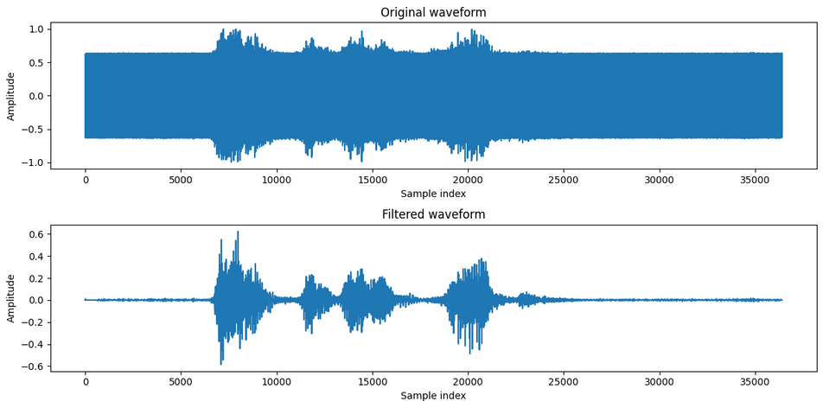
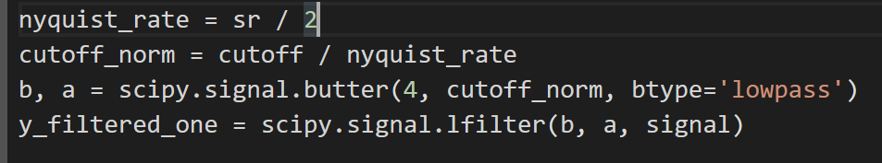
Noise Removal
We used the buttercup method for noise removal.
We made a filter and then applied the filter on our data to get a filtered signal.
We set the cutoff at 5000 Hz

Slide 7
Feature Extraction
We are using the following set of features to train our model:
MFCCS
Chromagram
Melspectrogram
Spectral Centroid
Spectral Contrast
Spectral Bandwidth
Spectral Rolloff
Spectral Faltness

Slide 8
Dimensionality reduction
We are using Linear Discriminative Analysis for Dimensionality reduction instead of principal component analysis, as it was giving better result.

Slide 9
Models
KNN
Logistic
Naive Bayes
SVM
Neural Net

Slide 10
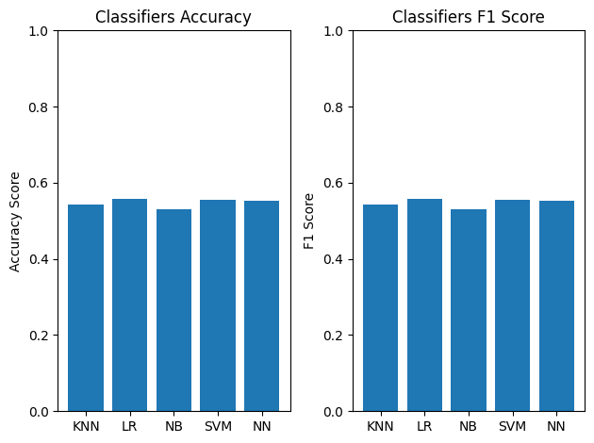
Result and finding
Accuracy Score of different models
KNN: 54.1%
Logistic Regression: 55.6%
Naive Bayes: 52.9%
SVM: 55.5%
Neural Network: 55.3%

Slide 11
Conclusion
Before performing sentiment analysis, we removed noise from the dataset to ensure accurate results.
.
We tested multiple classification algorithms and found that Support Vector Machines (SVM), Neural Netwrok, and Logistic Regression have almost equal accuracy ( 55%) for predicting the sentiment of an audio file.
Our findings indicate that sentiment analysis can be used in the real world to analyze customer feedback and responses, and make data-driven decisions.

Slide 12
THANK YOU

